Slide 1
Stephan von Bandemer
Anna Nimako-Doffour
Munscheidstr. 14
45886 Gelsenkirchen
Tel. +49.209/1622.1193
bandemer@iat.eu
IQEA within the ECVET-System

Slide 2
Overview
Challenges of IQEA
Added Value of ECVET and EQF
What makes ECVET and EQF valuable?
How ECVET works
ICVET within EQF
SWOT analysis of IQEA and ECVET
Potentials in the international (further-) training market

Slide 3
Challenges of IQEA
An increasing number of elderly people due to demographic change
The need of appropriate qualification for homecare givers
A high diversity of qualifications for care staff between European member states
Increasing mobility of homecare givers between member states
A lack of standards and recognition of qualification for homecare givers between member states
An increasing staff shortage in the field of homecare

Slide 4
Added Value of ECVET and EQF
The ECVET system describes different tasks and different levels of necessary knowledge, capabilities and competencies to fulfill the tasks assigned, ensuring…
that different levels of training can be made transparent;
that the different levels can be made comparable;
that acquired theoretical and practical competences can be made visible;
that a rational for recognition of qualifications is provided and
that continuous lifelong learning is supported.

Slide 5
What makes ECVET and EQF valuable?
27 states and 27 education systems prevent international mobility
EQF provides permeability from initial training to high level expertise
ECVET opens the education system for vocational training
Task orientation as basis for qualification oriented payment
Reference system for employers and employees

Slide 6
How ECVET Works
Care Process
Analysis and definition of relevant tasks and activities
Care Models
Definition of Reference Model and required knowledge, skills and competencies
Learning Outcome
Design of curricula and learning outcome with reference to independence and autonomy
Allocation of credit points in comparison to reference curricula and EQF
Credit Points

Slide 7
IECVET within EQF
Reference-Curriculum
EQF
International Curricula
Level 1
Level 3
Level 4
Level 2
Level 5
Level 6
Level 7
Level 8
Country B 13 CP
Reference curiculum
64 CP
Country C 51 CP
Country D 204 CP

Slide 8
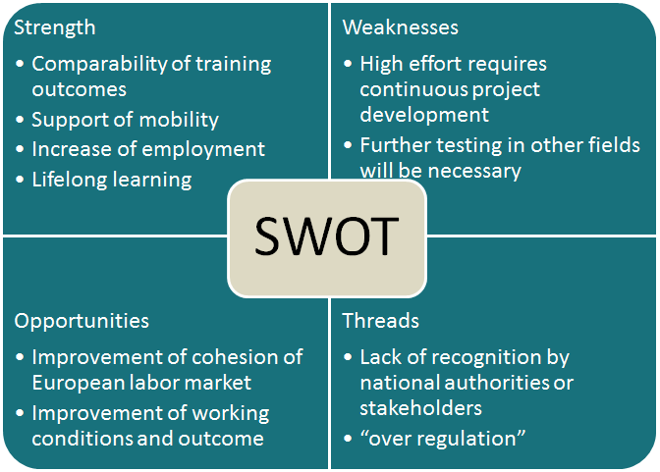
SWOT Analysis of IQEA within ECVET

Slide 9
How IQEA has addressed the Challenges
The elderly people receive improved support
Increased qualification for homecare givers provides employment opportunities
A qualification standard can be established between European member states
Mobility of homecare givers within and between member states is supported
Therefore staff shortage can be adressed reasonably

Slide 10
Potentials in the international (further-) training market
The international market for further training is estimated at 3 trillion US $ per year
Many countries look for successful systems for providing transparency and comparability of training
ECVET and EQF based trainings may become an export opportunity
Export of training is one of the most powerful drivers of industrial policy

Slide 11
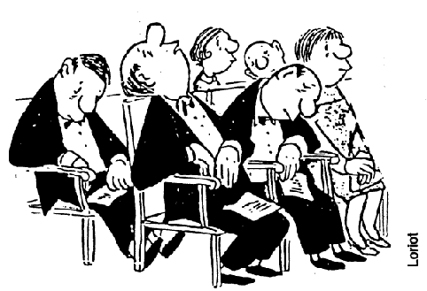
Thank you for your attention

